Slide 1
CS 176c Discussion Section 4/17

Slide 2
Review Questions
Describe the role of the beacon frames in 802.11.
Beacon frames are transmitted by the APs.
The beacon frames permit nearby wireless stations to discover and identify the AP.
Transmitted over one of the 11 channels.

Slide 3
Review Questions
True or false: Before an 802.11 station transmits a data frame, it must first send an RTS frame and receive a corresponding CTS frame.
FALSE.
It’s optional. Mostly used to avoid Hidden Terminals.

Slide 4
Review Questions
What are the differences between a master device in a Bluetooth network and a base station in an 802.11 network?
Any ordinary Bluetooth node can be a master node whereas access points in 802.11 networks are special devices
Normal wireless devices like laptops cannot be used as access points

Slide 5
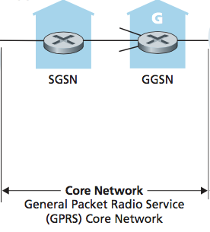
Review Questions
What is the role of the “core network” in the 3G cellular data architecture?
Serving GPRS Support Nodes (SGSNs) and Gateway GPRS Support Nodes (GGSNs)
SGSN is responsible for delivering datagrams to/from the mobile nodes in the radio access network to which the SGSN is attached.
The SGSN interacts with the cellular voice network’s MSC for that area, providing user authorization and handoff, maintaining location (cell) information about active mobile nodes, and performing datagram forwarding between mobile nodes in the radio access net- work and a GGSN.
The GGSN acts as a gateway, connecting multiple SGSNs into the larger Internet.

Slide 6
Review Questions
What are the three important differences between the 3G and 4G cellular architectures?
3G | 4G
Separate network components and paths for voice and data. (Public telephone n/w vs. public internet) | 4G has a unified, all-IP network architecture
3G architecture doesn’t have a clear distinction between data and control plane | The architecture clearly separates data and control plane
Uses radio access network UTRAN | Uses an enhanced radio access network E-UTRAN

Slide 7
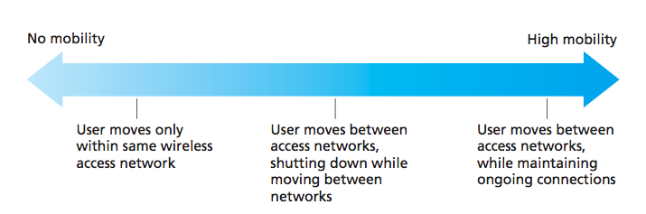
Review Questions
If a node has a wireless connection to the Internet, does that node have to be mobile? Explain. Suppose that a user with a laptop walks around her house with her laptop, and always accesses the Internet through the same access point. Is this user mobile from a network standpoint? Explain.
No.
A mobile node is the one that changes its point of attachment into the network over time.
Since the user is always accessing the Internet through the same access point, she is not mobile.

Slide 8
Review Questions
What is the difference between a permanent address and a care-of address? Who assigns a care-of address?
A permanent address for a mobile node is its IP address when it is at its home network.
A care-of-address is the one its gets when it is visiting a foreign network.
The COA is assigned by the foreign agent (which can be the edge router in the foreign network or the mobile node itself).

Slide 9
Problems
One proposed solution that allowed mobile users to maintain their IP addresses as they moved among foreign networks was to have a foreign network advertise a highly specific route to the mobile user and use the existing routing infrastructure to propagate this information throughout the network. We identified scalability as one concern. Suppose that when a mobile user moves from one network to another, the new foreign network advertises a specific route to the mobile user, and the old foreign network withdraws its route. Consider how routing information propagates in a distance-vector algorithm (particularly for the case of inter-domain routing among networks that span the globe).

Slide 10
Problems
Will other routers be able to route datagrams immediately to the new foreign network as soon as the foreign network begins advertising its route?
No.
Distance Vector algorithm (as well as the inter-AS routing protocols like BGP) is decentralized and takes some time to terminate.
While the algorithm is running, some of the routers may not be able to route datagrams to the destined node.

Slide 11
Problems
Is it possible for different routers to believe that different foreign networks contain the same mobile user?
Yes -> When one of the nodes has just left a foreign network and joined a new foreign network.
Note that the routing entries from the old foreign network might not have been completely withdrawn when the entries from the new network are being propagated.

Slide 12
Problems
Discuss the time scale over which other routers in the network will eventually learn the path to the mobile users.
The time it takes for a router to learn a path to the mobile node depends on the number of hops between the router and the edge router of the foreign network for the node

Slide 13
Problems
In mobile IP, what effect will mobility have on end-to-end delays of datagrams between the source and destination?
Because datagrams must be first forward to the home agent, and from there to the mobile, the delays will generally be longer than via direct routing.
It would depend on the delays on these various path segments.
Indirect routing also adds a home agent processing (e.g., encapsulation) delay.
Note that it is possible, however, that the direct delay from the correspondent to the mobile (i.e., if the datagram is not routed through the home agent) could actually be smaller than the sum of the delay from the correspondent to the home agent and from there to the mobile.

Slide 14
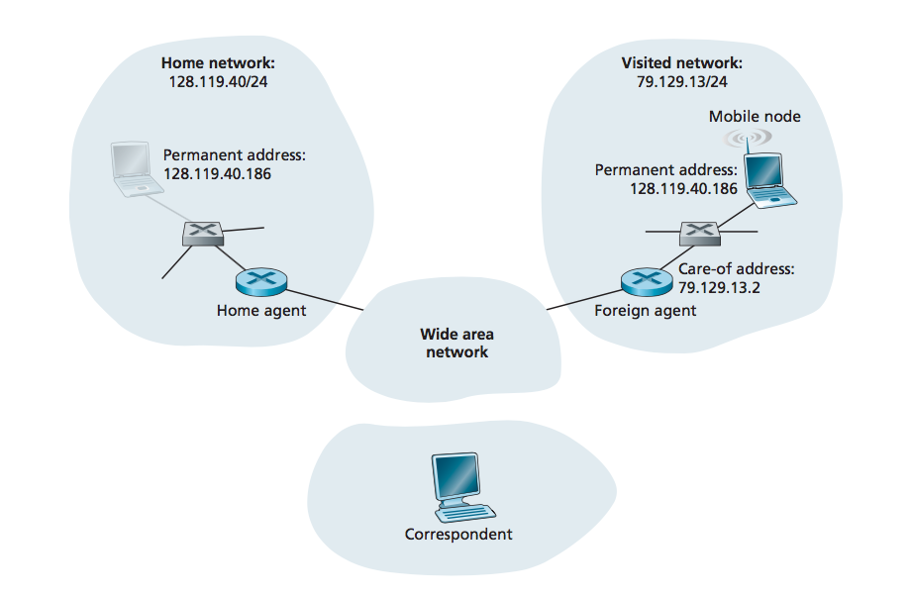
Problems
Suppose the correspondent in Figure were mobile. Sketch the additional network-layer infrastructure that would be needed to route the datagram from the original mobile user to the (now mobile) correspondent. Show the structure of the datagram(s) between the original mobile user and the (now mobile) correspondent

Slide 15
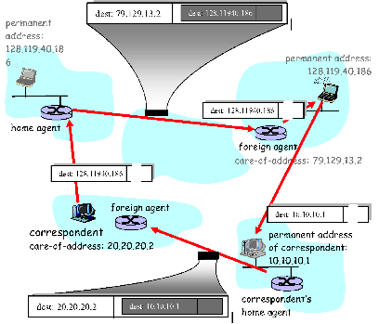
Notes:
If the correspondent is mobile, then any datagrams destined to the correspondent would have to pass through the correspondent’s home agent. The foreign agent in the network being visited would also need to be involved, since it is this foreign agent that notifies the correspondent’s home agent of the location of the correspondent.
Datagrams received by the correspondent’s home agent would need to be encapsulated/tunneled between the correspondent’s home agent and foreign agent, (as in the case of the encapsulated diagram at the top of Figure 6.23)

